Slide 1
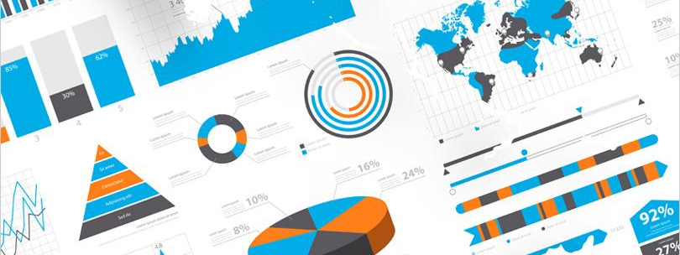
Adda.com
A hub for all your data work.
Ideas, Meet, Socialize, Share, Create a story

Slide 2

What are we doing?
The most essential tool for all data people.
“Data is every where, but nowhere”
- Vishwanath(vish)

Slide 3

How it works?
How can we break the wall?
Business
Technology
Product
Traditional
approach
Business
Technology
Data
Product
Adda approach

Slide 4
Recipe to make good food(Data)
Understand your customer taste
Get the right ingredients from the market source
Clean the ingredients
Focus on target ingredients
Add your “education” to make it more authentic

Slide 5
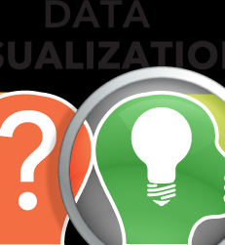
AI Data Visualization
Create data visualization application where any one can access from any where.
Create a story with your data.
Why is it important to visualize data?

Slide 6

Why we need Data visualization?
Data visualization is a quick, easy way to convey concepts in a universal manner and you can experiment with different scenarios by making slight adjustments.

Slide 7
Why we need Data visualization?
Data visualization can also:
Identify areas that need attention or improvement.
Clarify which factors influence customer behavior.
Help you understand which products to place where.
Predict sales volumes*.

Slide 8
Prototype wireframe and use case
https://wireframe.cc/mDPNd5
Use case
The most common use today is as a BI “reporting” tool.
Framing strong theory about the Strategies and their approach for the subject matter experts.
Helping and brings data administrators, subject matter expects and data scientist as a team.

